Slide 1



Analyze Covid-19 RNA Seq Data.
Finding differentially expressed genes using DESeq2.
Daniel Marri
Michigan State University Biomedical Engineering
bhattacharyalabmsuiq

Slide 2
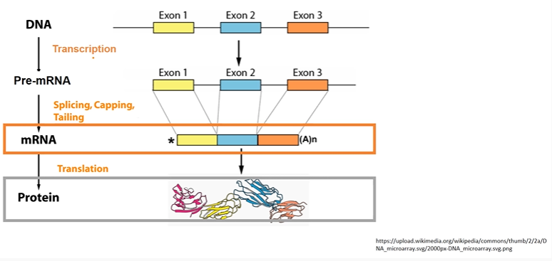
What is and why RNA-Seq?

Slide 3
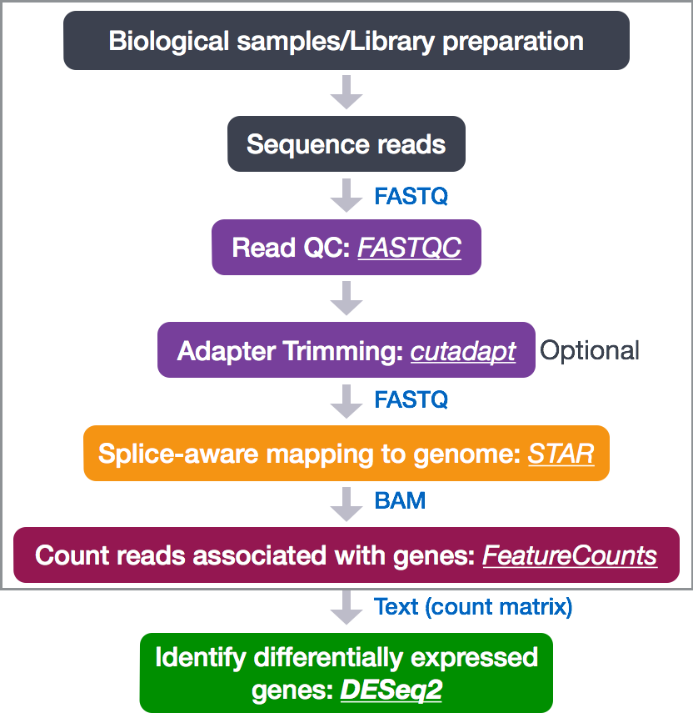
RNA-Seq Workflow

Slide 4
DIFFERENTIAL GENE EXPRESSION OF SARS-COV-2 INFECTION OF PRIMARY HUMAN LUNG EPITHELIUM FOR COVID 19.
DATASET FROM:
SARS-COV-2 Infection of primary human lung epithelium of COVID 19 modeling of drug discovery
RNA-Seq data : GES160435
(https://www.ncbi.nlm.nih.gov//geo/query/acc.cgi?acc=GSE160435)
NUMBER OF MOCK SAMPLES = 5
NUMBER OF INFECTED SAMPLES 5
TOTAL NUMBER OF SAMPLES = 10

